Slide 1
DSCI-531: FAIRNESS IN ARTIFICIAL INTELLIGENCE SUPERVISED LEARNING
Keith Burghardt
January 24, 2024

Slide 2
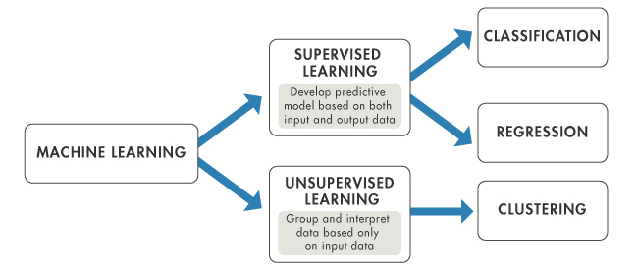
Supervised vs unsupervised learning
Based on sample/training data and their given class labels or categories, is it possible to train a model that generalizes over unseen data to decide what class the sample belongs to?
Output:label
Binary
Categorical
Output: response/outcome
Binary
Real
Source: DeepAI.org

Slide 3
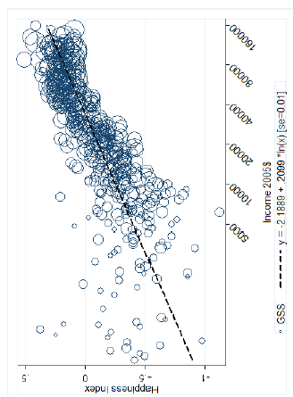
Why regression?
Source: US General Social Survey
(Linear) regression models data as a line
Increasing independent variable x increases (or decreases) the outcome y
Modeling monotonic relationships
Powerful and flexible tool for understanding the world
Creates an interpretable model that explains the data

Slide 4
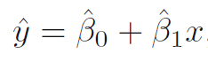
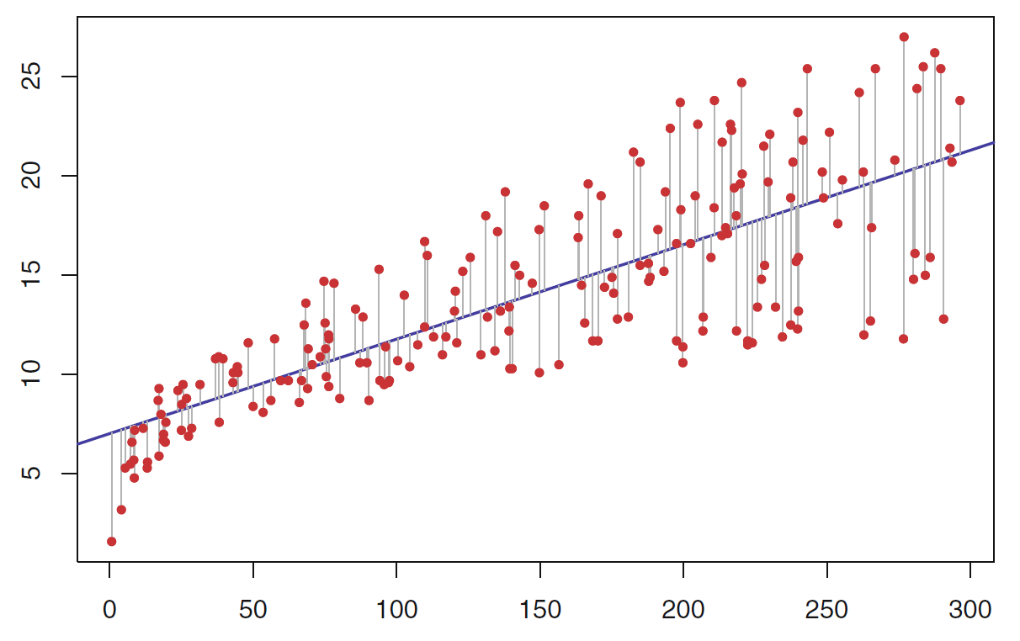
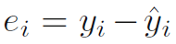
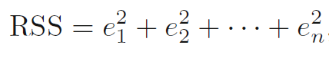
Linear regression
Parametric model: y = β₀ + β₁x
X: observed features
y: observed response (outcome)
Model parameters β₀ and β₁ estimated from data
Prediction:
Residual error:
Residual sum of squares (RSS) for n data
observed
y
modeled
x

Slide 5
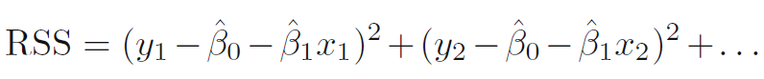
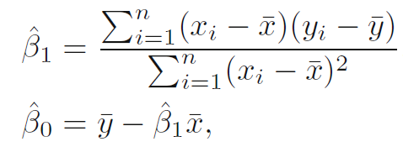
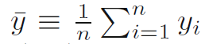
Mathematical intuition: OLS
RSS:
Choose parameters that minimize RSS. Ordinary least squares coefficient estimates
are sample means

Slide 6
Voice Pitch Example: Creating a model
RQ: How much does the voice pitch of males and females differ?
Collect data
Population of men and women saying the word “mama”
Measure pitch, Bigger Hz 🡪 higher pitch
Subject | Sex | Voice.Pitch
1 | Female | 233 Hz
2 | Female | 204 Hz
3 | Female | 242 Hz
4 | Male | 130 Hz
5 | Male | 112 Hz
6 | Male | 142 Hz

Slide 7
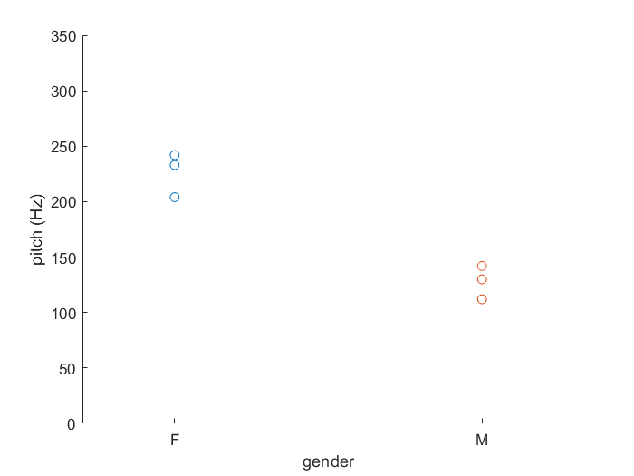
Voice Pitch Example: Creating a model
Could the differences arise purely by chance?
Perhaps men and women have similar pitch
Experimenter just got unlucky
Regression
Typical values for the pitch of men/women
Confidence about how likely these values are

Slide 8
A simple model
pitch ~ sex
Independent variable
Explanatory variable
Predictor
Fixed effect
Dependent variable
Outcome
Notes:
Pitch predicted by sex
Pitch as a function of sex

Slide 9
A simple model
Many other unmeasurable factors could affect pitch (culture, personality, age, nerves, …) – variations among individuals
pitch ~ sex + ε
Dependent variable
Outcome
Response
Independent variable
Explanatory variable
Predictor
Feature
Fixed effect
Error term
Random factors

Slide 10
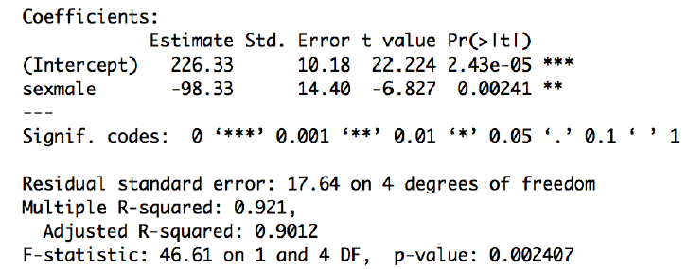
Fitting model to the data
R-squared (R2) reflects how much variance in data is accounted for by differences between males and females.
R2 = 92% of variance explained. Closer to 1 is better, but realistically, it won’t be that high.

Slide 11
Fitting model to the data
Adjusted R-squared (R2) controls for the complexity of the model: reflects how much variance in data is accounted for by the model considering how many variables it uses.

Slide 12
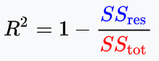
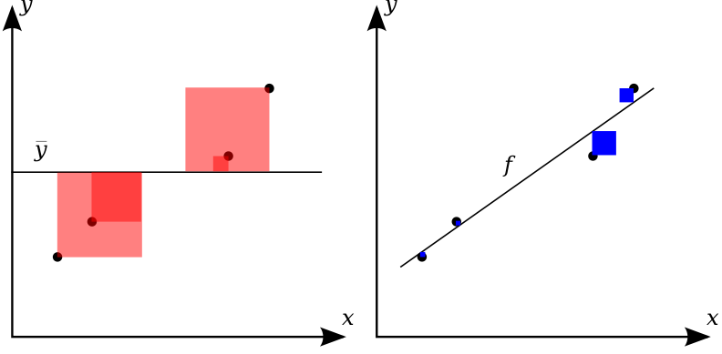
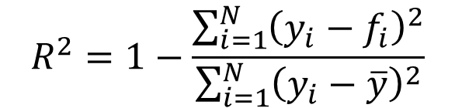
Coefficient of determination – R2
How much of the variation in y is explained by the variation in x? E.g., how much of the variation in pitch is explained by differences between males and females?

Slide 13
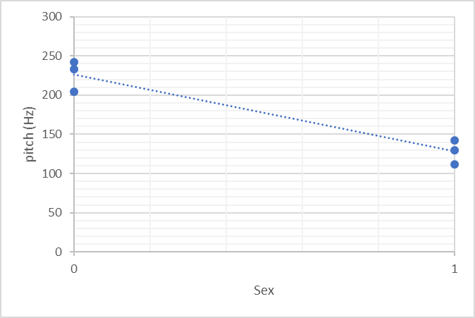
Fitting a model to data
intercept
Coefficient (slope)

Slide 14
Significance – p-value
Could a null hypothesis, rather than regression, explain the data?
Null hypothesis: sex has no effect on pitch
P-value: probability our data could be observed given that the null hypothesis is true
With p-value = 0.002, this probability is very low
Then the alternative hypothesis “Sex affects pitch” is more likely.
🡪 The regression result is statistically significant

Slide 15
Multiple regression model
pitch ~ sex + age + dialect+ ε

Slide 16
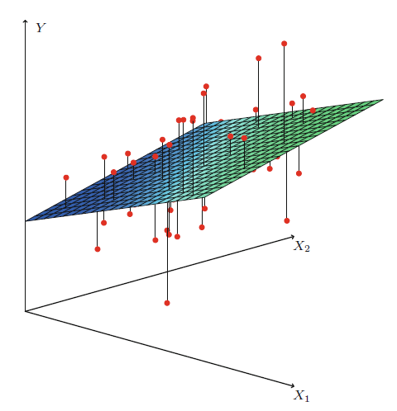
Linear multi-dimensional model

Slide 17
ISSUES TO CONSIDER WHEN USING REGRESSION

Slide 18
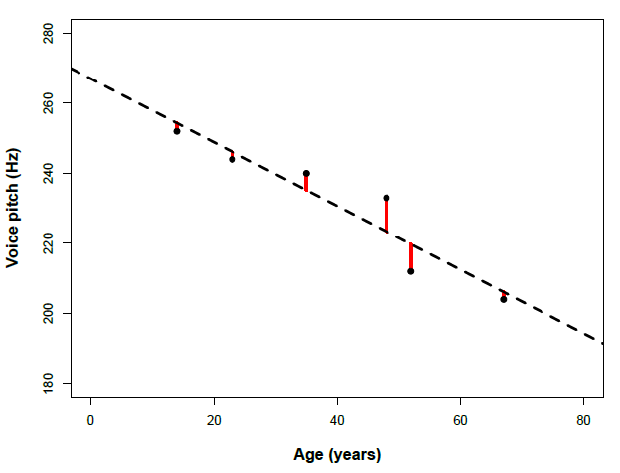
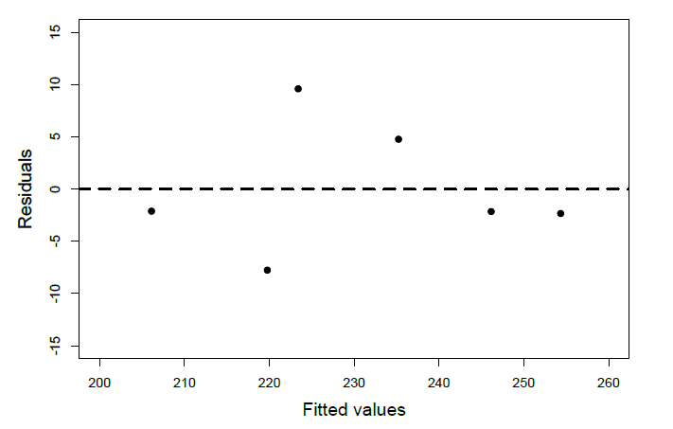
Assumptions of linear models
Linearity – dependent variable is assumed to be a linear combination of the independent variables/features
Ideally, residuals are normally distributed around 0
Errors (residuals)
Residual plot

Slide 19
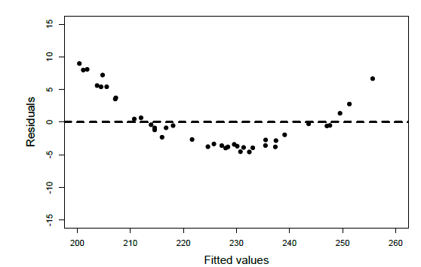
Check the residuals!
Did you miss an important fixed effect that interacts with whatever fixed effects you already have in your model?
Perform a nonlinear transformation of your outcome, e.g., by taking the log-transform.
Perform a nonlinear transformation of the fixed effects. E.g., if age were related to pitch in a U-shaped way, then you could add age and age2 (age-squared) as predictors.
If you’re seeing stripes in the residual plot, then you’re most likely dealing with some kind of categorical data – use a different class of models, such as logistic models
If your residuals look like this, the linearity assumption is violated

Slide 20
Assumptions of linear models: absence of collinearity
If two fixed effects are correlated with each other, they are collinear.
intelligence ~ syllables per second + words per second
Fixed effects are correlated
Different linear combinations of fixed effects can produce the same response
Cannot interpret coefficients
Use PCA, feature selection, etc. to choose a smaller set of explanatory fixed effects

Slide 21
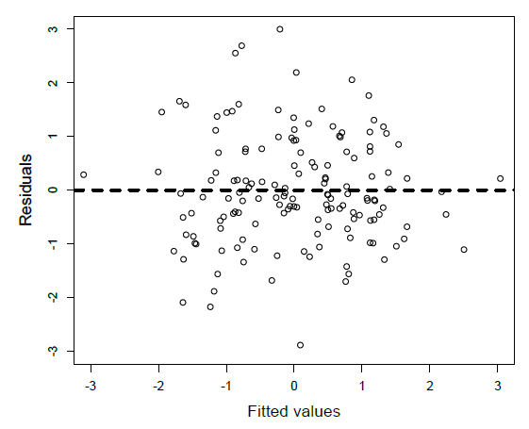
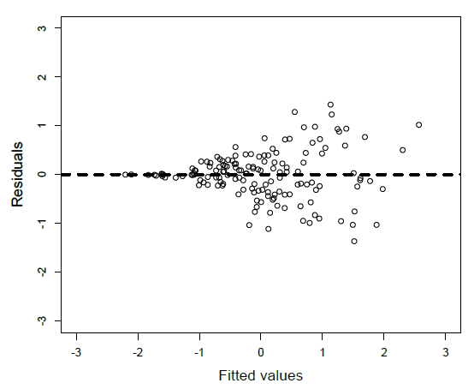
Homoskedasticity
Unequal variances: Does the variance of the data stage the same across the range of predicted values (homoscedasticity) or does it change (heteroskedasticity).
Consider log-transforming the data.
homoscedastic
heteroscedastic

Slide 22
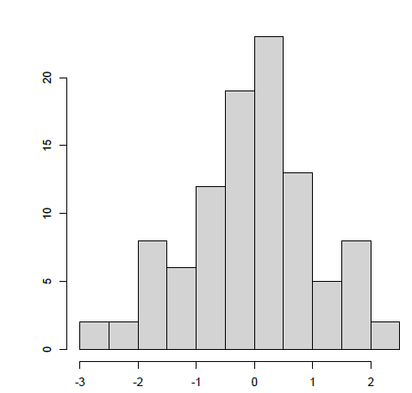
Normality of residuals
Does the distribution of residuals look normal?
Least important: linear models are robust to violations of normality
Histogram of residuals
Residuals plot

Slide 23
Outliers
Influential points: does leaving one data point out substantially change regression coefficients?
Outliers that lie away from the center of the cloud in the x-direction are called high leverage points.
A point is influential if including or excluding the point would considerably change the slope of the regression line.
Do not exclude them from analysis, unless there is an obvious error with the data

Slide 24
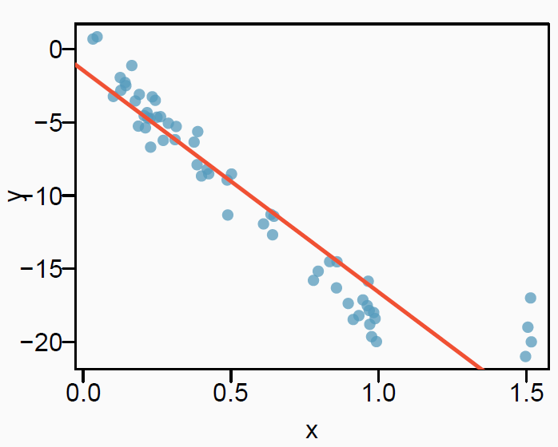
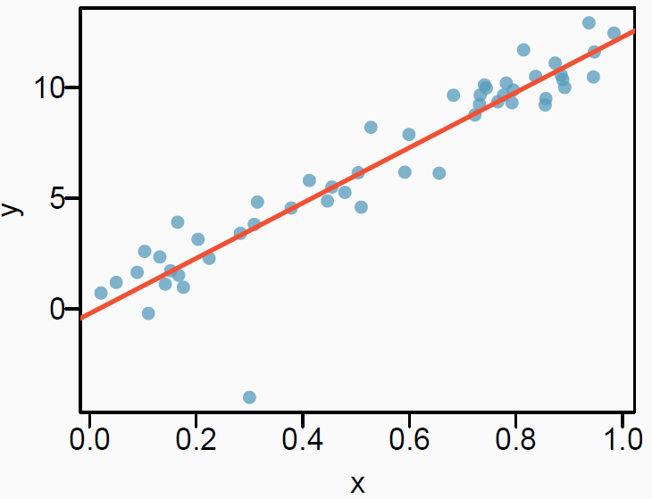
Types of outliers
How do outliers affect the regression line in this plot?
To answer, consider what the regression line would be without the outliers.
(top) Outliers pull the regression line away from the observations in the larger group of data.
(bottom) This outlier does not influence the regression line

Slide 25
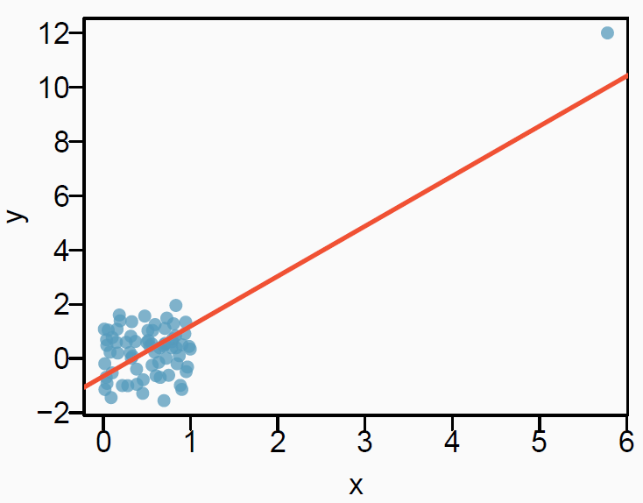
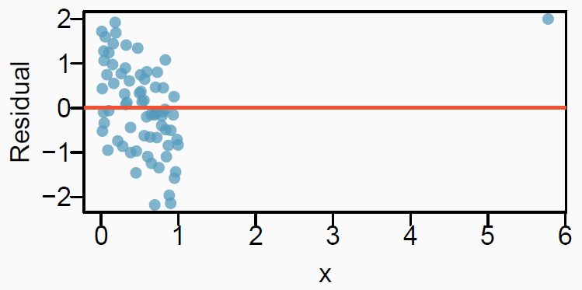
Types of outliers: influential points
How do outliers affect the regression line in this plot?
Without the outlier, there is no observable relationship between x and y.
Influential points: does leaving one data point out substantially change regression coefficients?
Do not exclude them from analysis, unless there is an obvious error with the data

Slide 26
Independence assumption
Most important assumption for linear models
Each data point is independent of others
i.e., comes from a different subject
Study 1
Study 2
Subject | Sex | Voice.Pitch
1 | Female | 233 Hz
2 | Female | 204 Hz
3 | Female | 242 Hz
4 | Male | 130 Hz
5 | Male | 112 Hz
6 | Male | 142 Hz
Subject | Age | Voice.Pitch
1 | 14 | 252 Hz
2 | 23 | 244 Hz
3 | 35 | 240 Hz
4 | 48 | 233 Hz
5 | 52 | 212 Hz
6 | 67 | 204 Hz

Slide 27
MIXED EFFECTS MODELS

Slide 28
Independence assumption is often violated!
More complex research questions require collecting multiple responses from the same subject
But, multiple responses from the same subject cannot be regarded as independent from each other
Every person has a slightly different voice pitch, and this idiosyncratic factor will affect all responses from the same subject, making them inter-dependent rather than independent
subject | gender | scenario | frequency
F1 | F | 1 | 213.3
F1 | F | 1 | 204.5
F1 | F | 2 | 285.1
F1 | F | 2 | 259.7
F1 | F | 3 | 203.9
F1 | F | 3 | 286.9
F3 | F | 1 | 229.7
F3 | F | 1 | 237.3
F3 | F | 2 | 236.8
F3 | F | 2 | 251
F3 | F | 3 | 267
F3 | F | 3 | 266
M4 | M | 1 | 110.7
M4 | M | 1 | 123.6
M4 | M | 2 | 229
M4 | M | 2 | 114.9
M4 | M | 3 | 112.2

Slide 29
Independence assumption is often violated
Research question: Does politeness affect pitch?
pitch ~ politeness + sex + ε
Each subject gives multiple responses: polite and informal response
Multiple responses from the same subject cannot be regarded as independent from each other
Every person has a slightly different voice pitch, and this idiosyncratic factor will affect all responses from the same subject, making them inter-dependent rather than independent
Add a random effect
This allows us to resolve this non-independence by assuming a different “baseline” pitch for each subject.

Slide 30
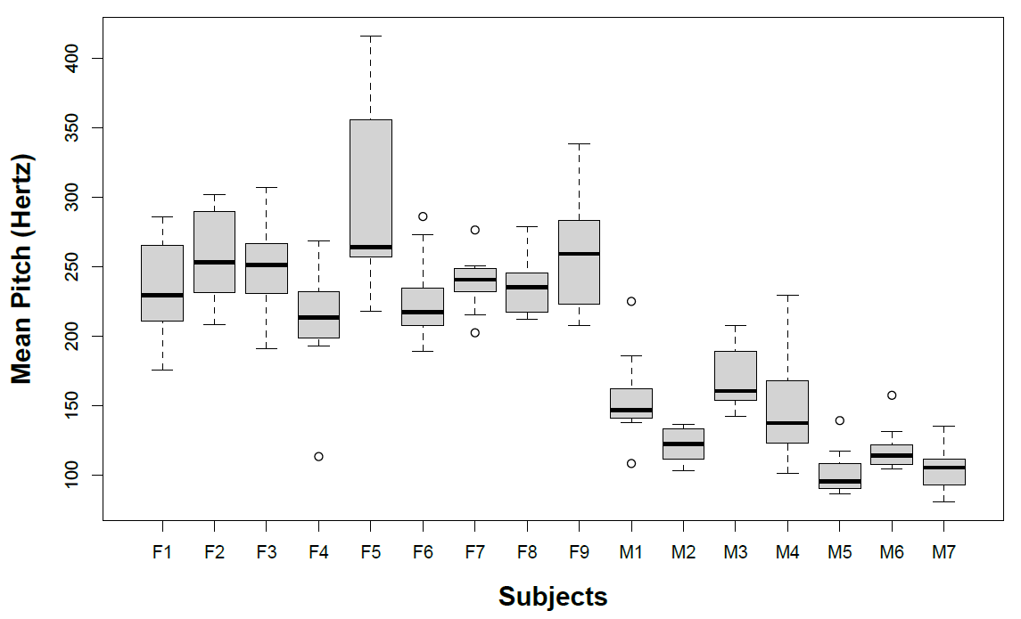
Lots of individual variation
mixed_effect_on_politness_data.ipynb

Slide 31
Modeling individual differences with random effects
Model individual differences by assuming different random intercepts for each subject.
Each subject is assigned a different intercept value, and the mixed model estimates these intercepts.
Mixed model adds one or more random effects to the fixed effects model.
These random effects give structure to the error term “ε”.
In the model, each “subject” becomes a random effect, and this characterizes idiosyncratic variation that is due to individual differences.

Slide 32
Mixed effects model
pitch ~ politeness + sex + (1|subject) + ε
“(1|subject)” means a different intercept for each subject”
“1” stands for the intercept.
Formula tells the model to expect multiple responses per subject, and these responses will depend on each subject’s baseline level.
This resolves the non-independence that stems from having multiple responses by the same subject.
Error term “ε” captures remaining “random” differences between different utterances from the same subject.

Slide 33
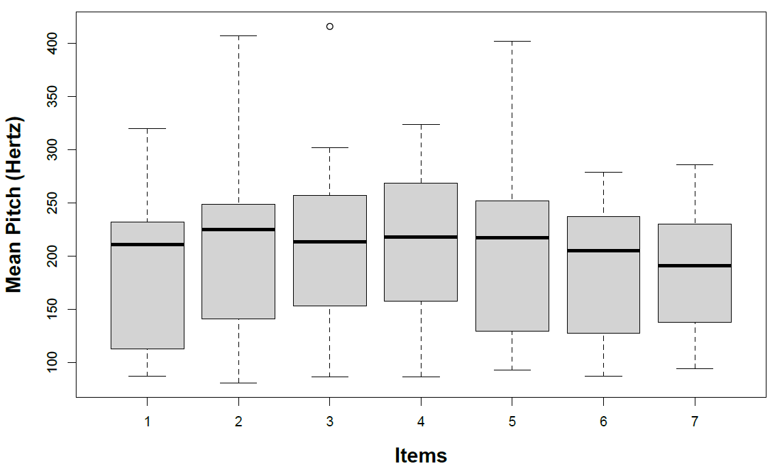
Modeling multiple dependencies
Systematic per-item variation
Some utterances (items) may have a higher pitch not explained by politeness and subject, but due to another factor that affects the voice pitch of all subjects (e.g., embarrassment)
Not accounting for this, violates the independence assumption

Slide 34
Multiple mixed effects model
pitch ~ politeness + sex + (1|subject) + (1|item) + ε
The model knows there are multiple responses per subject and per item
1|subject : Different intercepts for different subjects
1|item: Different intercepts for different items.
We now “resolved” these non-independencies and accounted for per-subject and per-item variation in overall pitch levels.

Slide 35
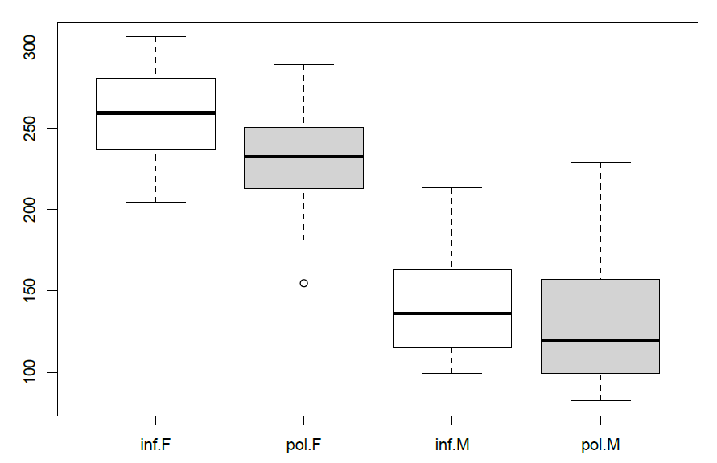
Illustration on “Politeness” data
pitch ~ attitude + sex + (1|subject) + (1|item) + ε
Informal speech by females
Polite speech by males

Slide 36
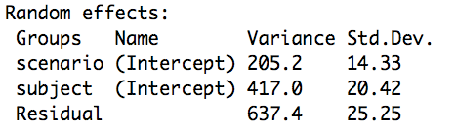
Random effects
pitch ~ attitude + gender + (1|subject) + (1|scenario) + ε
Gender explains much of the between-subject variability in pitch. Without explicitly modeling gender, the subject variance is much higher.
Residual - ε term – is the variability that is not due to “item” or “subject”

Slide 37
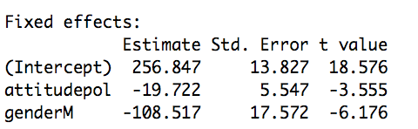
Fixed effects
pitch ~ attitude + gender + (1|subject) + (1|scenario) + ε
The coefficient “attitudepol” is the slope for the categorical effect of politeness.
Minus 19.695 means going from “informal” to “polite” utterances decreases the pitch by -19.695 Hz.
Polite speech has lower pitch than informal speech
Coefficient of “genderM” is negative
Males have lower pitch than females

Slide 38
Statistical significance of mixed effects models
Variety of opinions about the best approach
Likelihood ratio test
Probability of observing the data you collected given the model you learned.
The logic of the likelihood ratio test is to compare the likelihood of two models with each other.
Null model: The model without the factor that you’re interested in
pitch ~ gender + (1|subject) + (1|scenario) + ε
Full model: with the factor that you’re interested in.
pitch ~ attitude + gender + (1|subject) + (1|scenario) + ε

Slide 39
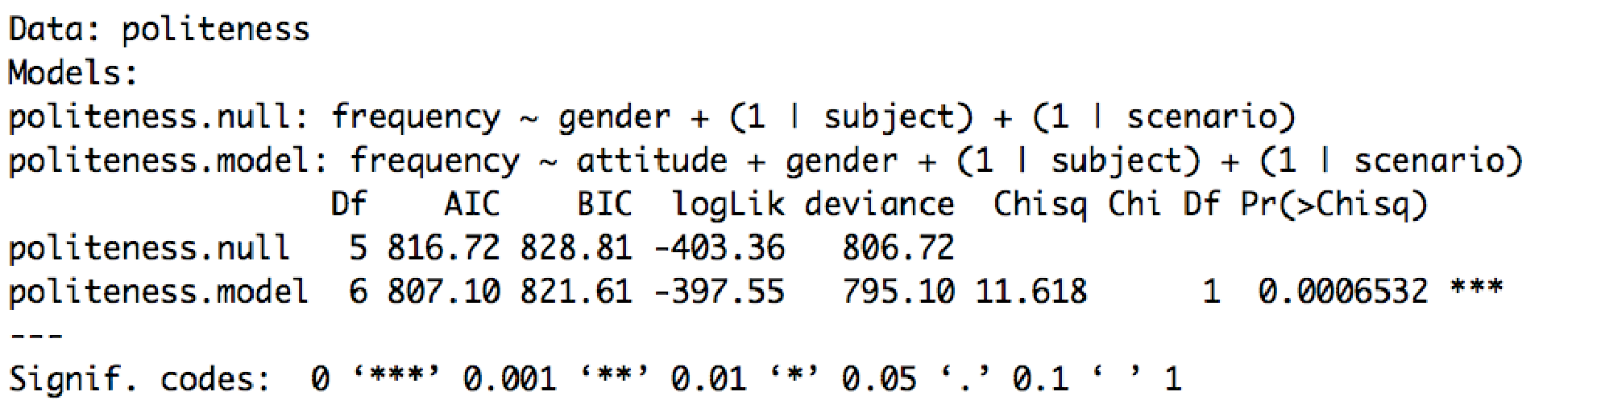
Likelihood ratio test
perform the likelihood ratio test using a standard package (eg, anova)
Report the effect in a paper as follows:
“… politeness affected pitch (χ2(1)=11.62, p=0.00065), lowering it by about 19.7 Hz ± 5.6 (standard errors) …”

Slide 40
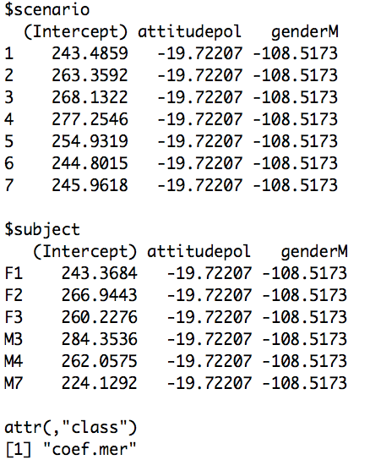
Random slopes vs random intercepts
pitch ~ attitude + gender + (1|subject) + (1|scenario) + ε
Different intercept for each subject and each item
Different baselines for each subject
But the same coefficients: Fixed effects of gender and attitude are the same for all subjects and items
Need a model with random slopes to allow subjects to have individualized responses to fixed effects

Slide 41
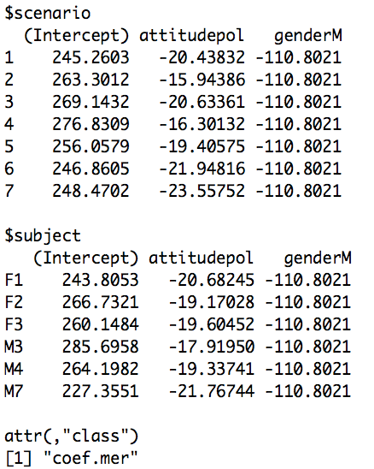
Mixed effects with random slopes
pitch ~ attitude + gender + (1+attitude|subject) + (1+attitude|scenario) + ε
Coefficient for the effect of politeness (“attitudepol”) is different for each subject and item
despite individual variation, there is also consistency in how politeness affects voice: pitch tends to go down when speaking politely

Slide 42


Slide 43
Pitfalls and best practices
Overfitting
Information leakage
Finding the optimal model
Feature engineering
Feature transformation
E.g., when features have a large range, take log transform
Correlated features
Feature selection
Regularization

Slide 44
Overfitting
Avoid overfitting
It may be tempting to create an “optimal” model
But, a complex model that performs well on training data, may not generalize
It may have learned to specialize to existing data
reduce parameters (simplify the model)
Signs of overfitting: very high R2 on training data
New data
Y
X

Slide 45
Choosing the Optimal Model
The most complex model (using most predictors/features) will have the lowest training error: the smallest RSS and the largest R²
To compare different models, we can use other approaches:
AIC (Akaike information criterion)
BIC (Bayesian information criterion)
These adjust the training error for the model size, and can be used to select among a set of models with different numbers of variables.
Alternatively, choose a model with low test error. Remember that training error is usually a poor estimate of test error.
Estimate test error on held-out data or using a cross-validation approach.

Slide 46
Information leakage
Data
Avoid information leakage
Never test on the same data used for training
5-fold cross validation
Train on a random 80% of data, test on 20%
Average results over 5 random splits
Leave one out (for small data)
Train on N-1 data points, test on 1 point
For hyperparameter tuning
Train on 3 folds, validate on 1 fold, test on 1 fold
Train
Test
Train
Tune
Test

Slide 47
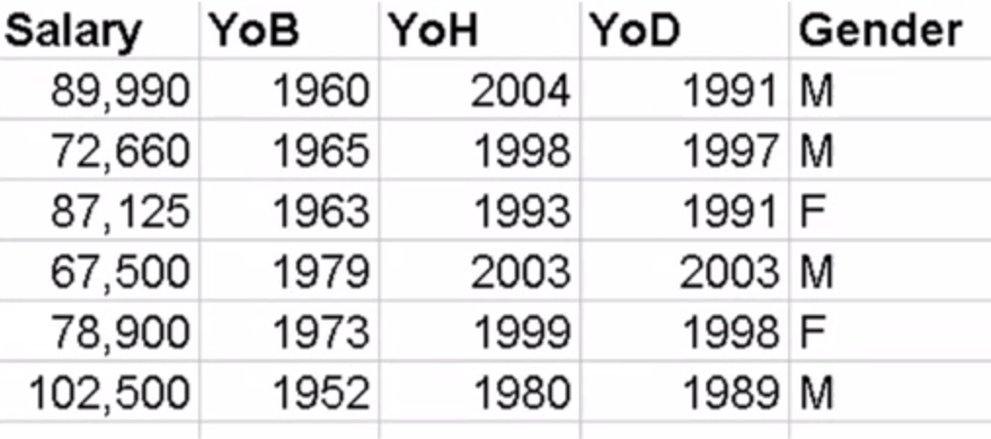
Feature transformation
Transform features to make more interpretable model
Create a model of male faculty salary at UCI. Use the model to predict female faculty salary.
Model y=Salary as a function of X:
Year of birth (YoB)
Year of hire (YoH)
Year of degree (YoD)
Salary = 3,420,751 – 293*YoB – 808*YoD – 593*YoH

Slide 48
Feature transformation
Salary = 3,420,751 – 293*YoB – 808*YoD – 593*YoH
Instead, model Salary as a function of
Years since birth (Age)
Years since degree (YsD)
Years since hire (YsH)
Salary = 48,623 + 293*Age + 808*YsD + 593*YsH

Slide 49
Model Interpretability
When we have a large number of predictors/features in the model, there will generally be many that have little or no effect on the response.
Including such irrelevant variable leads to unnecessary complexity.
Leaving these variables in the model makes it harder to see the effect of the important variables.
The model would be easier to interpret by removing the unimportant variables, e.g., setting their coefficients to zero.

Slide 50
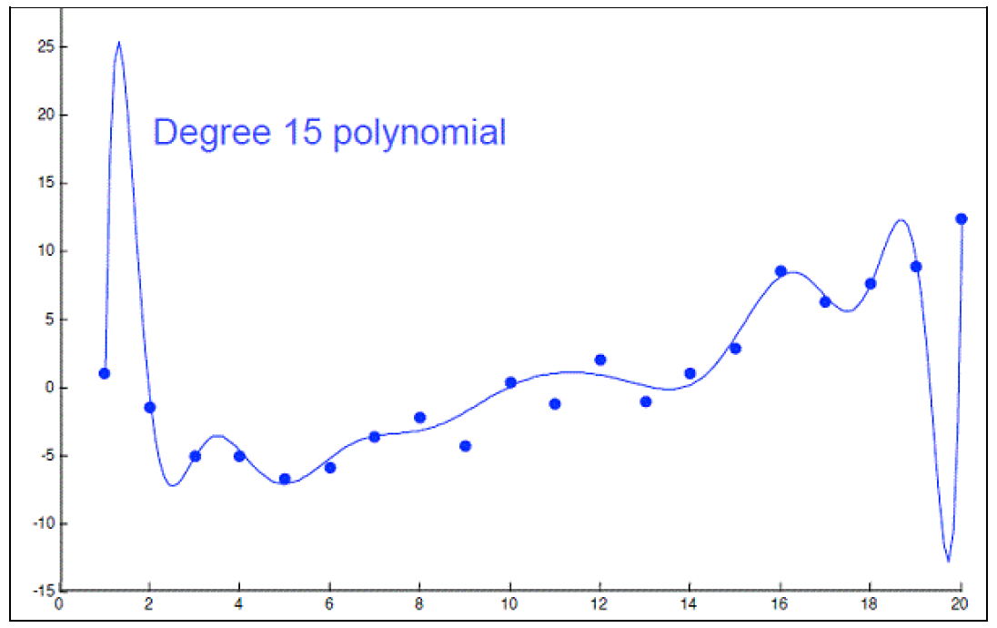
Feature Selection
Carefully selected features can improve model accuracy, but adding too many can lead to overfitting.
Overfitted models describe random error or noise instead of any underlying relationship.
They generally have poor predictive performance on test data.
For instance, we can use a 15-degree polynomial function to fit the following data so that the fitted curve goes nicely through the data points.
However, a brand new dataset collected from the same population may not fit this particular curve well at all.

Slide 51
Feature Selection
Subset Selection
Identify a subset of features most related to the outcome; fit a model using OLS on the reduced set.
Methods: forward feature selection, MRMR, …
Shrinkage (Regularization)
Involves shrinking the estimated coefficients toward zero relative to the OLS estimates; has the effect of reducing variance and performs variable selection.
Methods: ridge regression, lasso
Dimension Reduction
Involves projecting the p predictors into a M-dimensional subspace, where M < p, and fit the linear regression model using the M projections as predictors.
Methods: principal components regression, partial least squares

Slide 52
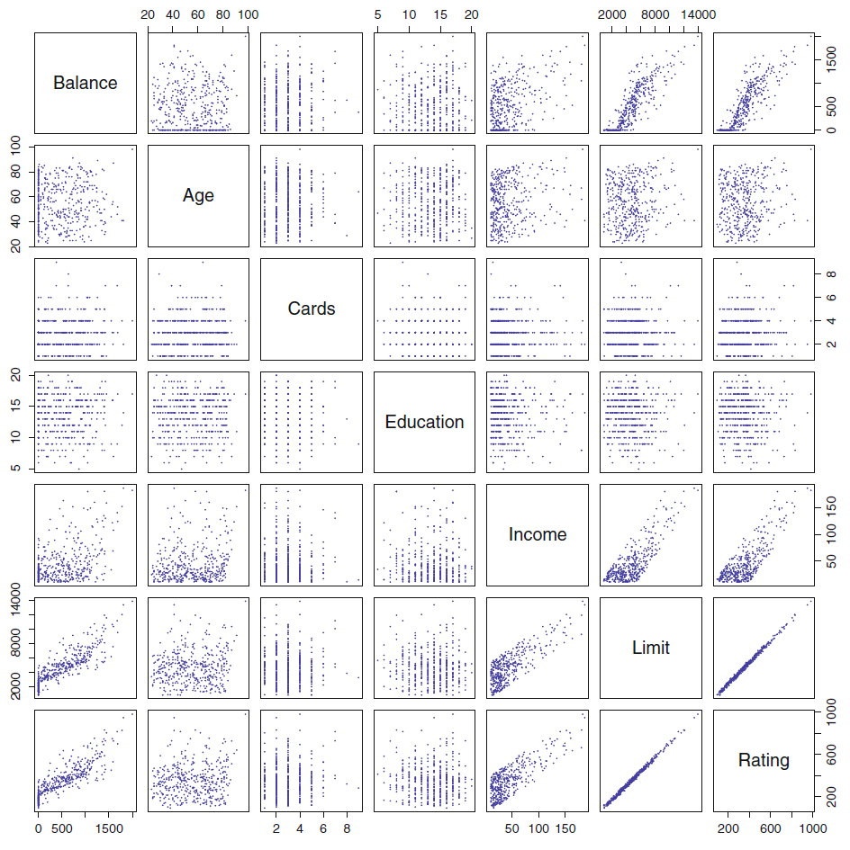
Multi-collinearity (Credit Card Data)
Scatter plots
Outcome:
Credit card balance
Features:
Age,
number of Cards,
years of Education,
Income,
credit Limit
credit Rating,

Slide 53
Feature selection & Multi-collinearity
Reduce the number of colinear features by eliminating un-informative features
Variance Inflation Factor - quantifies the severity of multicollinearity and measures how much the variance of an estimated regression coefficient is increased because of collinearity.
Rule of thumb – calculate VIF for each feature and eliminate features with VIF>5.
Minimum redundancy maximum relevance (mRMR) – identified features that are highly correlated with the outcome (relevance), but uncorrelated with each other (redundancy)

Slide 54
Choosing the Optimal Model
The model containing all the features/predictors will always have the smallest RSS and the largest R², since these quantities are related to the training error.
We wish to choose a model with low test error, not a model with low training error. Recall that training error is usually a poor estimate of test error.
Thus, RSS and R² are not suitable for selecting the best model among a collection of models with different numbers of predictors.

Slide 55
Other Measures of Comparison
To compare different models, we can use other approaches:
Adjusted R²
AIC (Akaike information criterion)
BIC (Bayesian information criterion)
Mallow’s C_{p} (equivalent to AIC for linear regression)
These techniques adjust the training error for the model complexity and can be used to select among a set of models with different numbers of variables.
These methods add penalty to RSS for the number of predictors in the model.

Slide 56
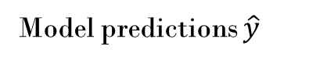
Linear models
Errors (residuals)
Outcome as a weighted sum of features: flexible, computable and interpretable models
Linearity (check residuals) 🡪 transform features
Homoscedasticity (check residuals) 🡪 consider transforming data
Normality (check residuals): p-values may be invalid
Correlated features 🡪 dimensionality reduction
Independence of observations 🡪 mixed effects models
Outliers
Interpretable
y
x
Residual plot
err

Slide 57
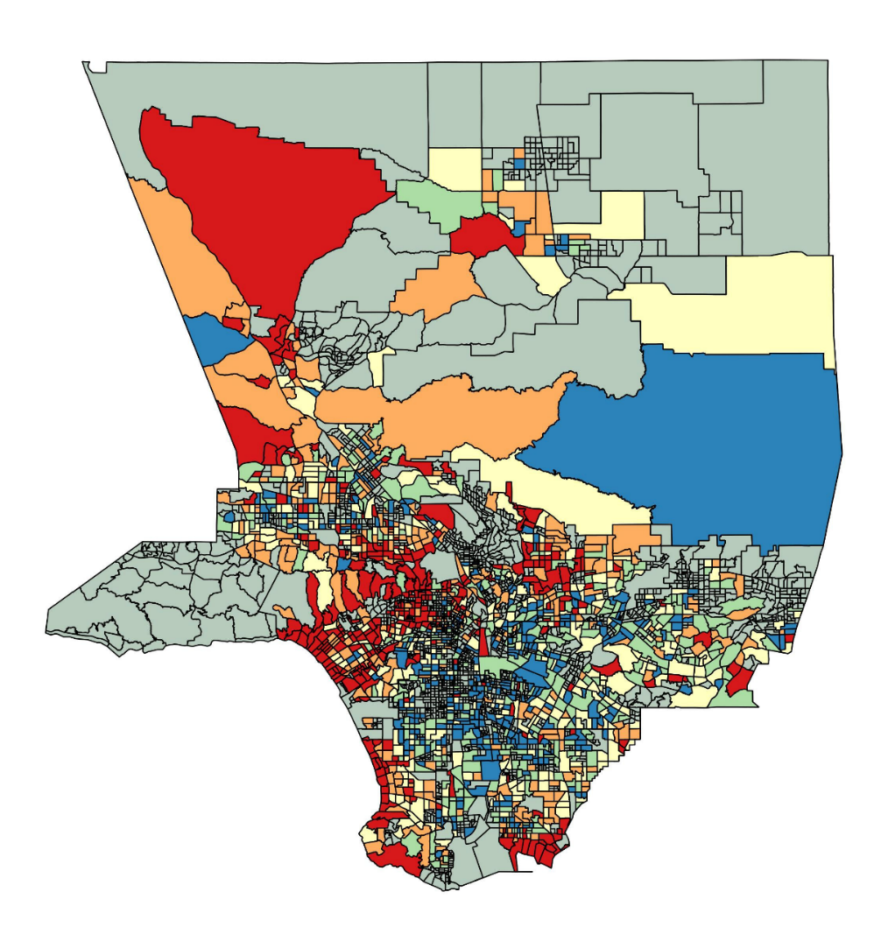

Sentiment around Los Angeles
Geocoded tweets from around Los Angeles County
Measure valence of tweets: how much positive or negative sentiment they express
* With David Garcia and Luciano Marin in ICWSM2016

Slide 58
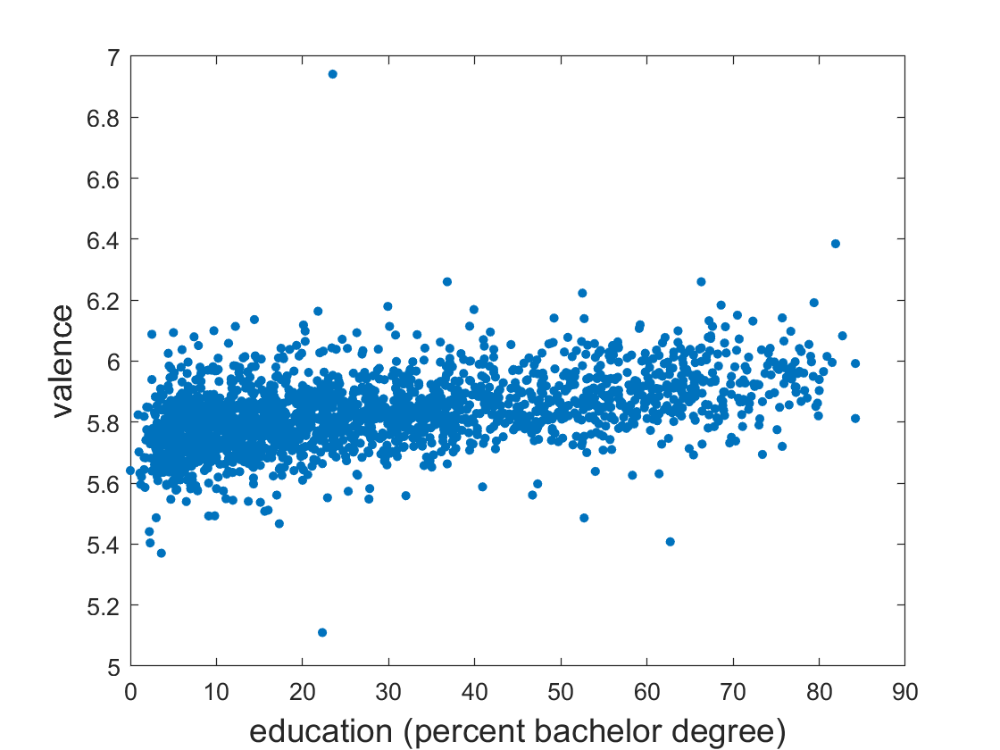
Model sentiment: education of neighborhood residents explains valence
TRACT | households_meanIncome | %_bachelorPlus | totalHispanics | totalWhites | meanV (valence)
1011.1 | 68938 | 19.4 | 1244 | 2319 | 5.864
1011.22 | 120490 | 27.2 | 304 | 2175 | 5.963
1012.1 | 54481 | 16.6 | 2434 | 2078 | 5.623
1012.2 | 51880 | 19.8 | 509 | 1370 | 5.688
…

Slide 59
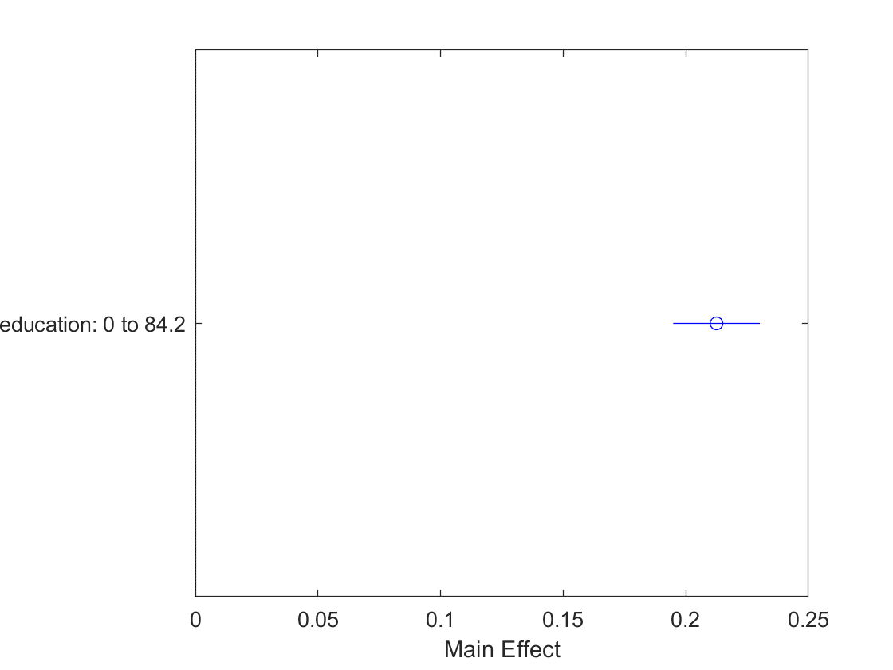
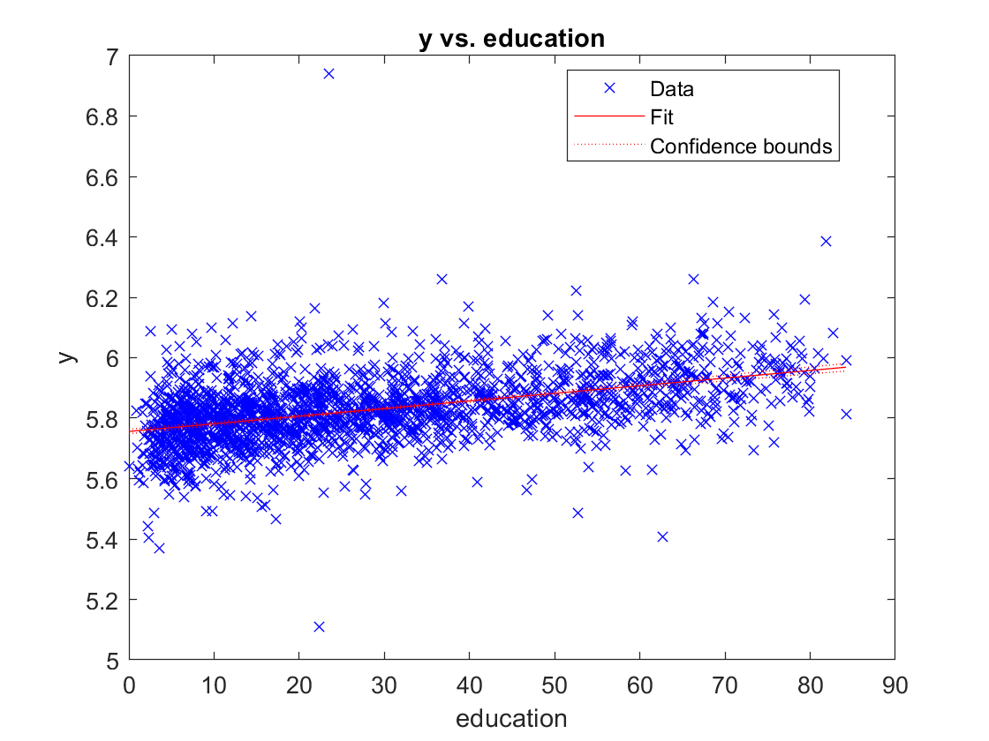
Simple model
Valence ~ education + ε
Number of observations: 2110, Error degrees of freedom: 2108
Root Mean Squared Error: 0.101
R-squared: 0.209, Adjusted R-Squared 0.209
F-statistic vs. constant model: 557, p-value = 1.6e-109

Slide 60
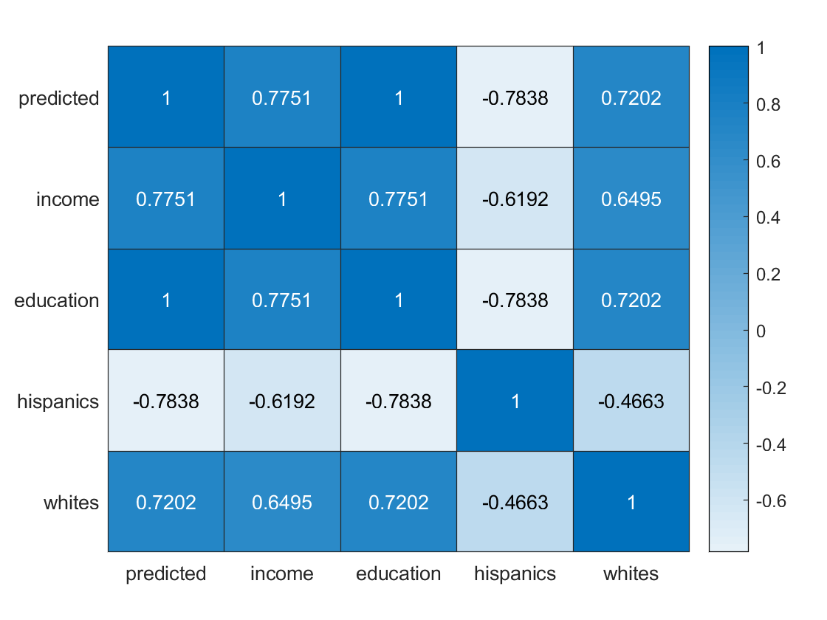
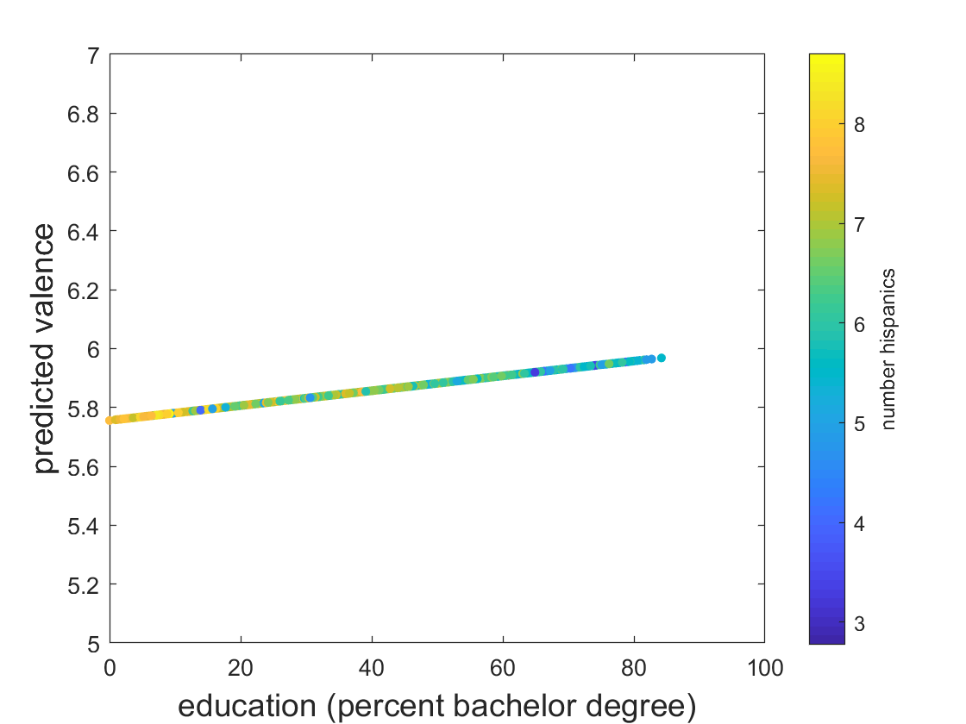
Potential bias?
Valence ~ education + ε
Correlation plots

Slide 61
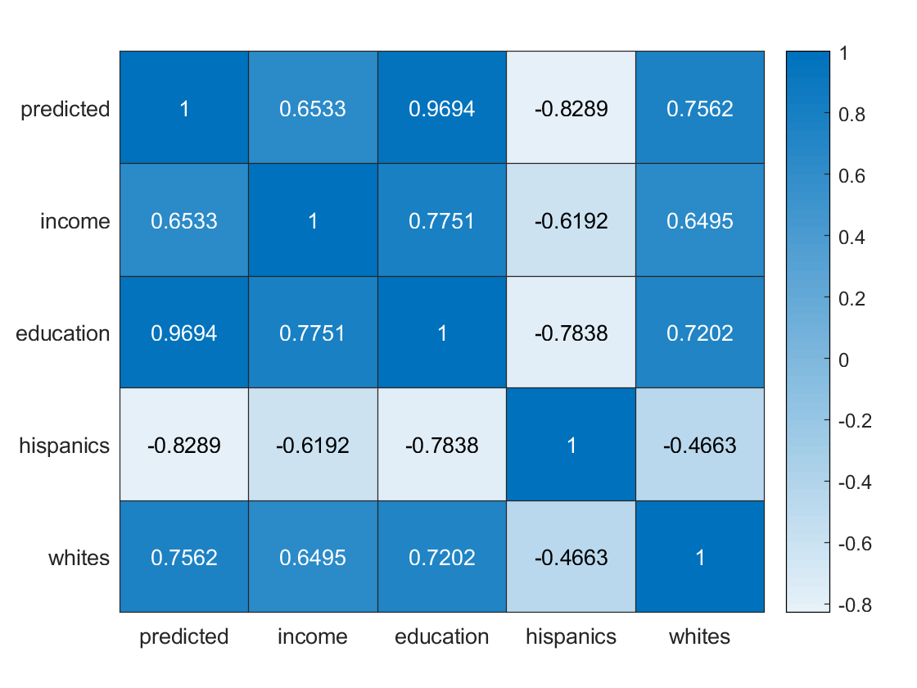
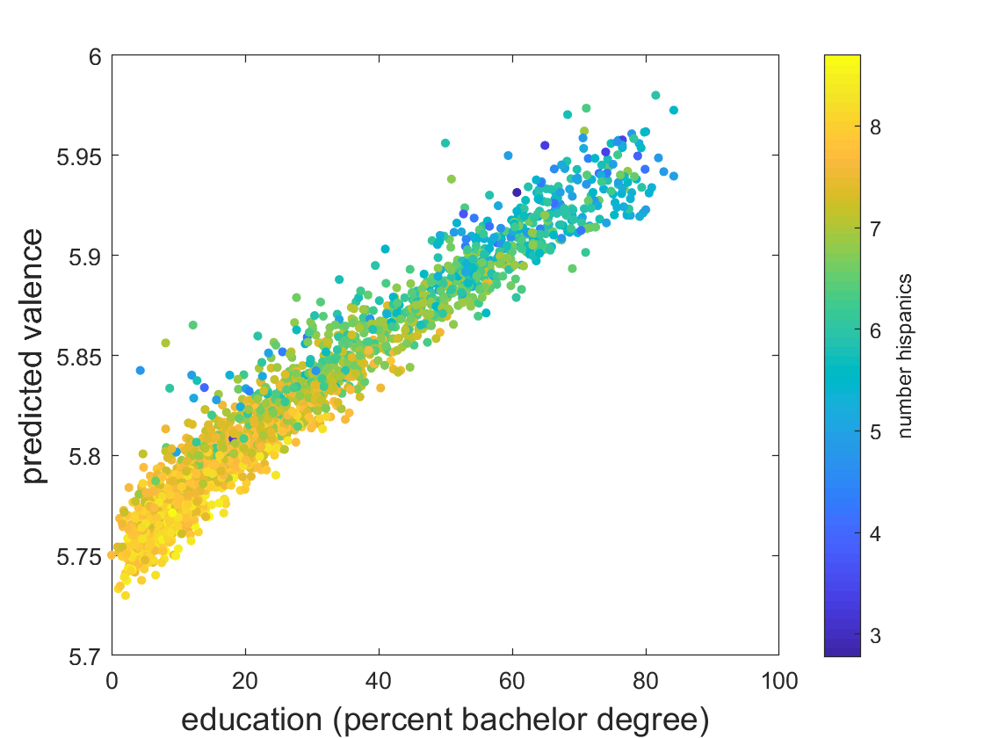
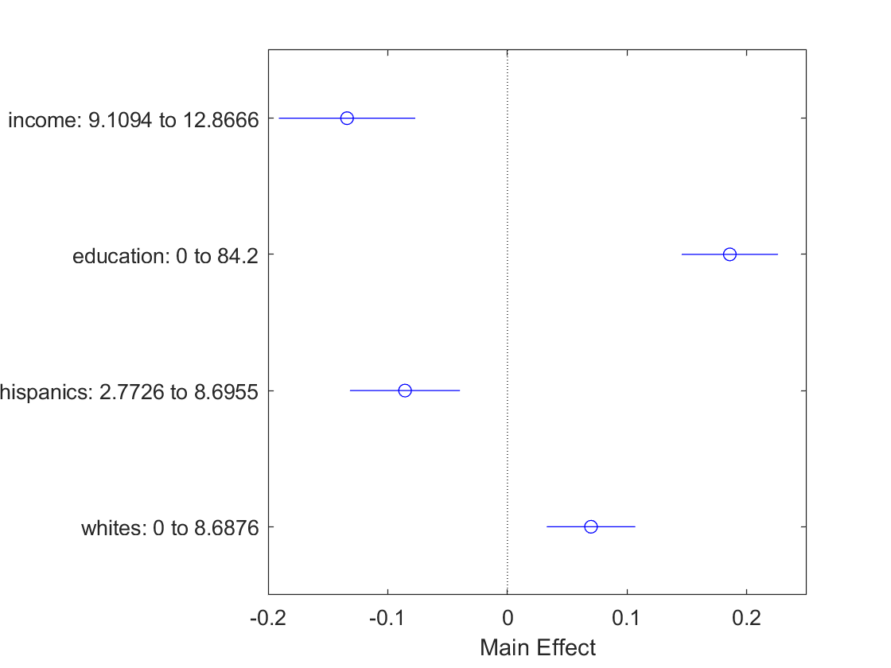
Full regression model
valence~ log(income) + education + log(Hispanics) + log(whites)

Slide 62
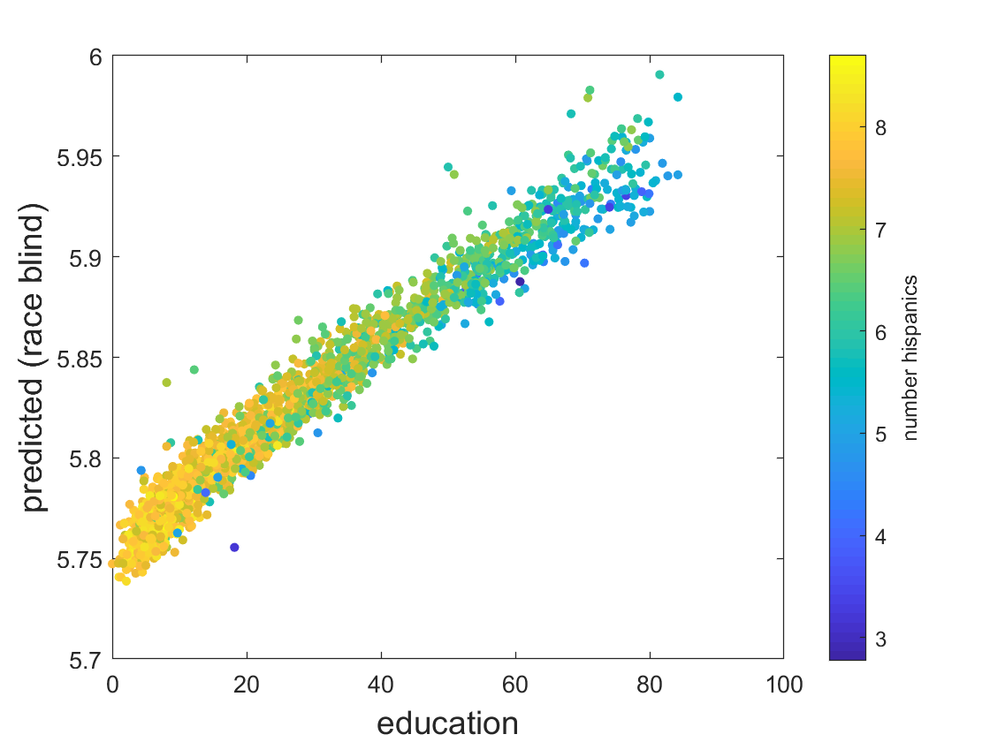

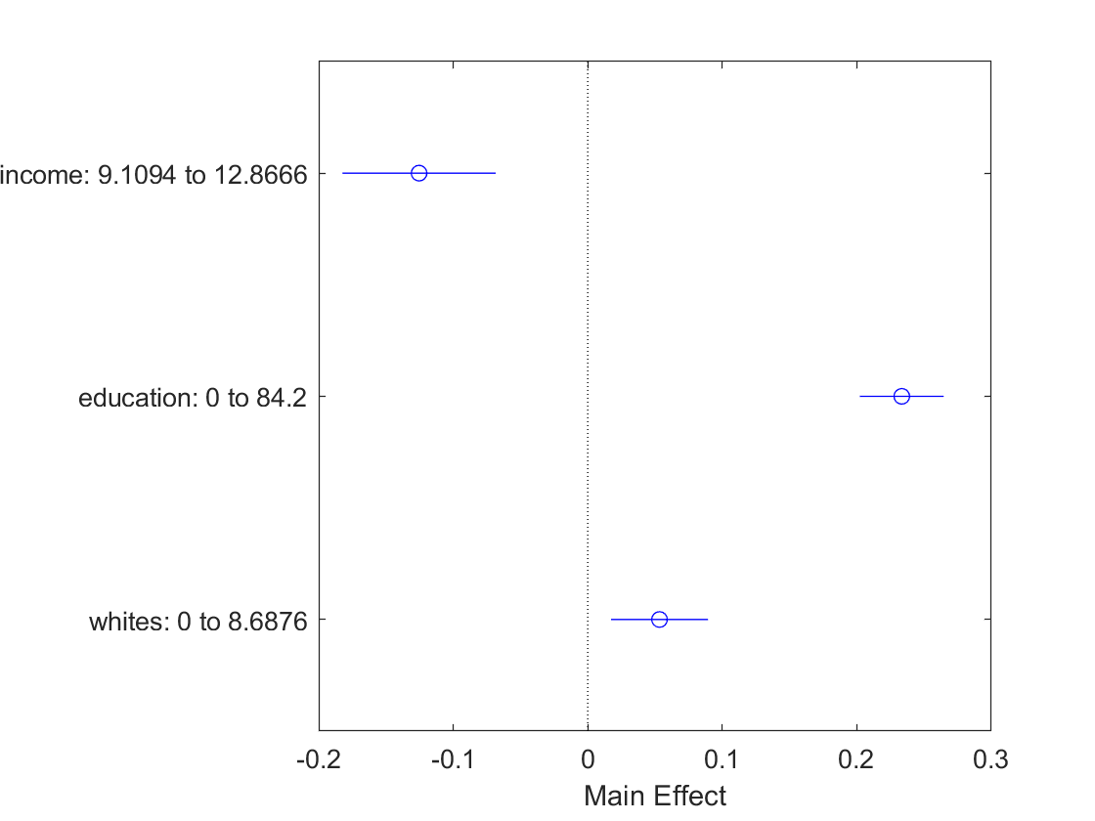
Race blind model
Protected variable – hispanics
valence ~ log(income) + education + log(whites)

Slide 63
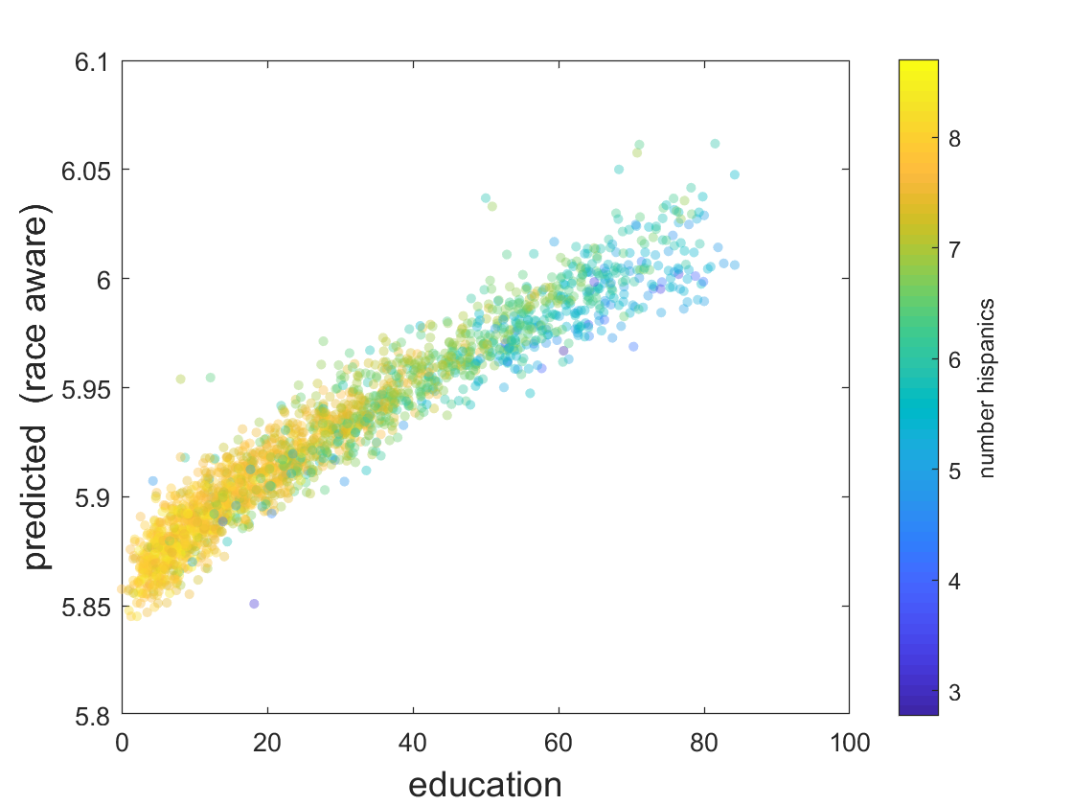

Race aware model
valence~ log(income) + education + log(Hispanics) + log(whites)
Predicted ~ log(income) + education + log(whites)

Slide 64


Fair model
Making predictions that are independent of the protected variable (number Hispanics)
[Method: He, Burghardt & Lerman, under review]

